Slide 1
Analysis of the Health Care Agency in the Healthcare Industry
Student’s Name
Course name and course number
Due date
Faculty member's name

Slide 2
Introduction
The presentation will begin with the discussion of healthcare agency, which is HRSA.
The website and appropriate artifact for HRSA will be provided
The next section will give one healthcare regulation in the healthcare industry
The website and an artifact for the regulation will be provided
The final section will entail the conclusion of the discussions.

Slide 3
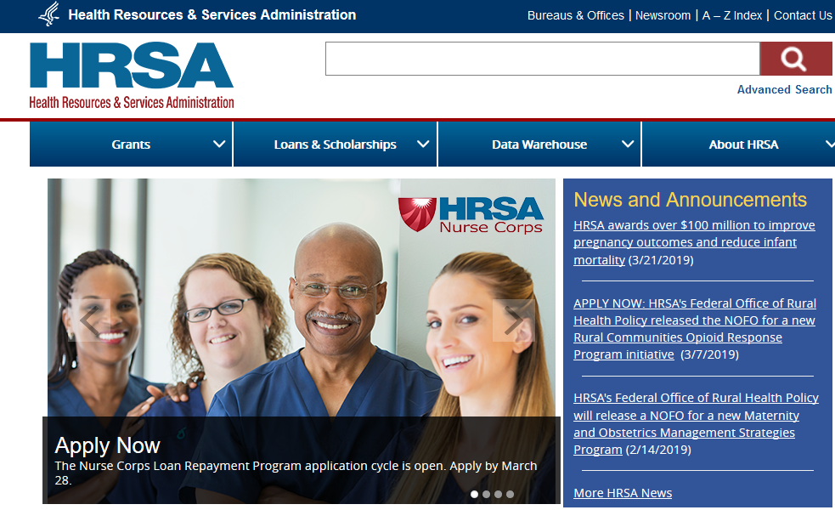
The Health Resources and Services Administration (HRSA)
HRSA is an agency of the U.S. Department of Health and Human Services.
HRSA’s website can be accessed at https://www.hrsa.gov/
The following s an artifact representing HRSA’s website

Slide 4
The Health Resources and Services Administration (HRSA)
HRSA is the primary federal agency for improving health care to people who are geographically isolated, economically or medically vulnerable.
HRSA also supports the training of health professionals, the distribution of providers to areas where they are needed most and improvements in health care delivery
A healthcare structure that must comply with the HRSA is a health center
The HRSA has led to improvement in the accessibility of healthcare to the US citizens, with more than 27 million relying on a HRSA-funded health center for affordable, accessible primary care.

Slide 5
Healthcare Regulation
One of the regulations affecting the delivery of healthcare services in the healthcare industry is the HIPPA Privacy Rule
The Rule requires appropriate safeguards to protect the privacy of personal health information, and sets limits and conditions on the uses and disclosures that may be made of such information without patient authorization
The Privacy Rule is located at 45 CFR Part 160 and Subparts A and E of Part 164
The rule can be accessed via https://www.hhs.gov/hipaa/for-professionals/privacy/index.html

Slide 6
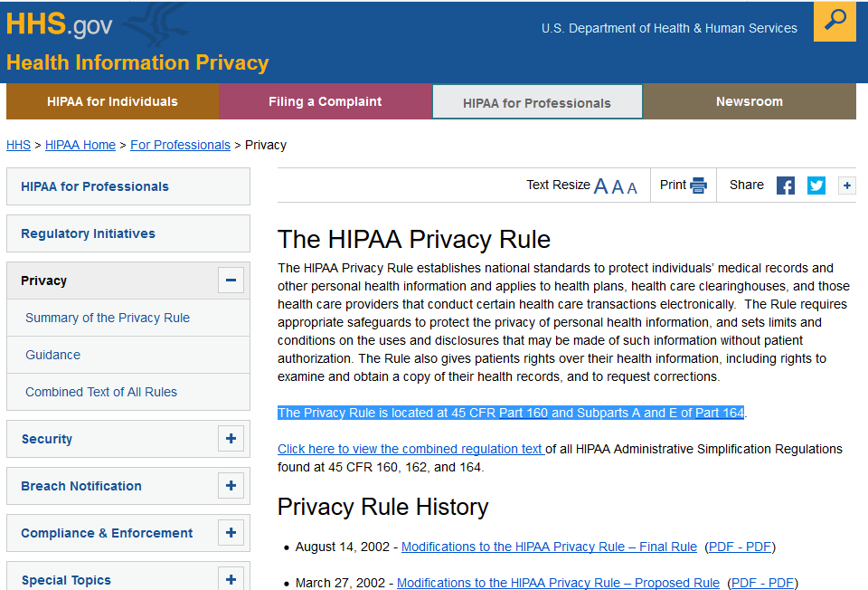
Healthcare Regulation
The artifact showcasing HIPPA Privacy rule is shown below

Slide 7
Healthcare Regulation
The HIPPA Privacy rule is carried out at both federal, state and local level.
All healthcare providers are expected to comply with this regulation. Therefore, an example of a structure required to comply with this regulation is a hospital.
The regulation has led to the protection of individual and personal medical information, in turn leading to trust among patients towards healthcare providers. The overall impact is the improved quality of healthcare services.

Slide 8
Conclusion
Healthcare agencies are important in the healthcare industry as they help in ensuring that the provision of healthcare is professional.
HRSA is the primary agency of the U.S. Department of Health and Human Services.
The agency has led to the creation of affordable healthcare system to more than 27 million US citizens.
HIPPA Privacy rule is a regulation requiring healthcare providers to maintain privacy of the medical records of their patients, hence promoting professionalism and trust in the healthcare industry.

Slide 9
References
US DHHS. (2019). HIPPA Privacy Rule. Retrieved from https://www.hhs.gov/hipaa/for-professionals/privacy/index.html
Cohen, G. & Mello, M. M. (2018). HIPAA and Protecting Health Information in the 21st Century. JAMA, 320 (3): 231-232
Washko, M. M., & Fennell, M. L. (2017). The Epicenter of Effectiveness and Efficiency in Health Care Delivery: The Evolving U.S. Health Workforce. Health services research, 52 Suppl 1(Suppl Suppl 1), 353-359.
HRSA. (2019). Agency Overview. Retrieved from https://www.hrsa.gov/sites/default/files/hrsa/about/hrsa-agency-overview.pdf

